Slide 1

Introduction to Machine Learning
Basic Statistics
Necessary for ML/Data Science

Slide 2
Basics of Hypothesis Testing
<Topic>

Slide 3


What is Hypothesis ?
Hypothesis is a predictive statement, capable of being tested by scientific methods, that relates an independent variables to some dependent variable.
A hypothesis states what we are looking for and it is a proportion which can be put to a test to determine its validity
e.g. Students who receive counseling will show a greater increase in creativity than students not receiving counseling
Notes:
The first question that arise in our mind is why Statistics?
Let me make you clear that Statistics is one of the key fundamental skills required for data science. Moving forward in the data science, if you go for any kind of algorithms then primarily knowledge in statistics is quite important. Actually, the statistics and probability are considered as the base knowledge and they are very essential for moving into any machine learning algorithms.

Slide 4
Characteristics of Hypothesis
Clear and precise.
Capable of being tested.
Stated relationship between variables.
limited in scope and must be specific.
Stated as far as possible in most simple terms so that the same is easily understand by all concerned. But one must remember that simplicity of hypothesis has nothing to do with its significance.
Consistent with most known facts.
Responsive to testing with in a reasonable time. One can’t spend a life time collecting data to test it.
Explain what it claims to explain; it should have empirical reference.
Notes:
The first question that arise in our mind is why Statistics?
Let me make you clear that Statistics is one of the key fundamental skills required for data science. Moving forward in the data science, if you go for any kind of algorithms then primarily knowledge in statistics is quite important. Actually, the statistics and probability are considered as the base knowledge and they are very essential for moving into any machine learning algorithms.

Slide 5
Null Hypothesis
It is an assertion that we hold as true unless we have sufficient statistical evidence to conclude otherwise.
Null Hypothesis is denoted by 𝐻₀
If a population mean is equal to hypothesised mean then Null Hypothesis can be written as:
𝐻₀: 𝜇 = 𝜇₀
Notes:
The first question that arise in our mind is why Statistics?
Let me make you clear that Statistics is one of the key fundamental skills required for data science. Moving forward in the data science, if you go for any kind of algorithms then primarily knowledge in statistics is quite important. Actually, the statistics and probability are considered as the base knowledge and they are very essential for moving into any machine learning algorithms.

Slide 6
Alternative Hypothesis
The Alternative hypothesis is negation of null hypothesis and is denoted by 𝐻_{𝑎}
If Null is given as
𝐻₀: 𝜇 = 𝜇₀
Then alternative Hypothesis can be written as
𝐻_{𝑎}: 𝜇 ≠ 𝜇₀
𝐻_{𝑎}: 𝜇 > 𝜇₀
𝐻_{𝑎}: 𝜇 < 𝜇₀
Notes:
The first question that arise in our mind is why Statistics?
Let me make you clear that Statistics is one of the key fundamental skills required for data science. Moving forward in the data science, if you go for any kind of algorithms then primarily knowledge in statistics is quite important. Actually, the statistics and probability are considered as the base knowledge and they are very essential for moving into any machine learning algorithms.

Slide 7
Levels of Significance and confidence
Significance means the percentage risk to reject a null hypothesis when it is true and it is denoted by 𝛼. Generally taken as 1%, 5%, 10%
(1 − 𝛼) is the confidence interval in which the null hypothesis will exist when it is true.
Notes:
The first question that arise in our mind is why Statistics?
Let me make you clear that Statistics is one of the key fundamental skills required for data science. Moving forward in the data science, if you go for any kind of algorithms then primarily knowledge in statistics is quite important. Actually, the statistics and probability are considered as the base knowledge and they are very essential for moving into any machine learning algorithms.

Slide 8
Risk of rejecting a Null Hypothesis when it is true
 | Designation | Risk 𝜶 | Confidence 𝟏 − 𝜶 | Description
 | Supercritical | 0.001 0.1% | 0.999 99.9% | More than $100 million (Large loss of life, e.g. nuclear disaster
 | Critical | 0.01 1% | 0.99 99% | Less than $100 million (A few lives lost)
 | Important | 0.05 5% | 0.95 95% | Less than $100 thousand (No lives lost, injuries occur)
 | Moderate | 0.10 10% | 0.90 90% | Less than $500 (No injuries occur)
Notes:
The first question that arise in our mind is why Statistics?
Let me make you clear that Statistics is one of the key fundamental skills required for data science. Moving forward in the data science, if you go for any kind of algorithms then primarily knowledge in statistics is quite important. Actually, the statistics and probability are considered as the base knowledge and they are very essential for moving into any machine learning algorithms.

Slide 9
Type I and Type II Error
Situation | Decision
 | Accept Null | Reject Null
Null is true | Correct | Type I error ( 𝛼 𝑒𝑟𝑟𝑜𝑟 )
Null is false | Type II error ( 𝛽 𝑒𝑟𝑟𝑜𝑟 ) | Correct
Notes:
The first question that arise in our mind is why Statistics?
Let me make you clear that Statistics is one of the key fundamental skills required for data science. Moving forward in the data science, if you go for any kind of algorithms then primarily knowledge in statistics is quite important. Actually, the statistics and probability are considered as the base knowledge and they are very essential for moving into any machine learning algorithms.

Slide 10




Two tailed test @5% Significance Level
Acceptance and Rejection regions in case of a Two tailed test
Suitable When
𝐻₀: 𝜇 = 𝜇₀
𝐻_{𝑎}: 𝜇 ≠ 𝜇₀
𝑅𝑒𝑗𝑒𝑐𝑡𝑖𝑜𝑛 𝑟𝑒𝑔𝑖𝑜𝑛
/𝑠𝑖𝑔𝑛𝑖𝑓𝑖𝑐𝑎𝑛𝑐𝑒 𝑙𝑒𝑣𝑒𝑙
(𝛼 = 0.025 𝑜𝑟 2.5%)
𝑅𝑒𝑗𝑒𝑐𝑡𝑖𝑜𝑛 𝑟𝑒𝑔𝑖𝑜𝑛
𝑇𝑜𝑡𝑎𝑙 𝐴𝑐𝑐𝑒𝑝𝑡𝑎𝑛𝑐𝑒 𝑟𝑒𝑔𝑖𝑜𝑛
𝑜𝑟 𝑐𝑜𝑛𝑓𝑖𝑑𝑒𝑛𝑐𝑒 𝑙𝑒𝑣𝑒𝑙
(1 − 𝛼) = 95%
𝐻₀: 𝜇 = 𝜇₀
/𝑠𝑖𝑔𝑛𝑖𝑓𝑖𝑐𝑎𝑛𝑐𝑒 𝑙𝑒𝑣𝑒𝑙
(𝛼 = 0.025 𝑜𝑟 2.5%)
Notes:
The first question that arise in our mind is why Statistics?
Let me make you clear that Statistics is one of the key fundamental skills required for data science. Moving forward in the data science, if you go for any kind of algorithms then primarily knowledge in statistics is quite important. Actually, the statistics and probability are considered as the base knowledge and they are very essential for moving into any machine learning algorithms.

Slide 11
Left tailed test @5% Significance Level
Acceptance and Rejection regions in case of a left tailed test
Suitable When
𝐻₀: 𝜇 = 𝜇₀
𝐻_{𝑎}: 𝜇 < 𝜇₀
𝑅𝑒𝑗𝑒𝑐𝑡𝑖𝑜𝑛 𝑟𝑒𝑔𝑖𝑜𝑛
𝑇𝑜𝑡𝑎𝑙 𝐴𝑐𝑐𝑒𝑝𝑡𝑎𝑛𝑐𝑒 𝑟𝑒𝑔𝑖𝑜𝑛
𝑜𝑟 𝑐𝑜𝑛𝑓𝑖𝑑𝑒𝑛𝑐𝑒 𝑙𝑒𝑣𝑒𝑙 (1 − 𝛼) = 95%
/𝑠𝑖𝑔𝑛𝑖𝑓𝑖𝑐𝑎𝑛𝑐𝑒 𝑙𝑒𝑣𝑒𝑙
(𝛼 = 0.05 𝑜𝑟 5%)
𝐻₀: 𝜇 = 𝜇₀
Notes:
The first question that arise in our mind is why Statistics?
Let me make you clear that Statistics is one of the key fundamental skills required for data science. Moving forward in the data science, if you go for any kind of algorithms then primarily knowledge in statistics is quite important. Actually, the statistics and probability are considered as the base knowledge and they are very essential for moving into any machine learning algorithms.

Slide 12
Right tailed test @5% Significance Level
Acceptance and Rejection regions in case of a right tailed test
Suitable When
𝐻₀: 𝜇 = 𝜇₀
𝐻_{𝑎}: 𝜇 > 𝜇₀
𝑅𝑒𝑗𝑒𝑐𝑡𝑖𝑜𝑛 𝑟𝑒𝑔𝑖𝑜𝑛
/𝑠𝑖𝑔𝑛𝑖𝑓𝑖𝑐𝑎𝑛𝑐𝑒 𝑙𝑒𝑣𝑒𝑙
(𝛼 = 0.05 𝑜𝑟 5%)
𝑇𝑜𝑡𝑎𝑙 𝐴𝑐𝑐𝑒𝑝𝑡𝑎𝑛𝑐𝑒 𝑟𝑒𝑔𝑖𝑜𝑛
𝑜𝑟 𝑐𝑜𝑛𝑓𝑖𝑑𝑒𝑛𝑐𝑒 𝑙𝑒𝑣𝑒𝑙
(1 − 𝛼) = 95%
𝐻₀: 𝜇 = 𝜇₀
Notes:
The first question that arise in our mind is why Statistics?
Let me make you clear that Statistics is one of the key fundamental skills required for data science. Moving forward in the data science, if you go for any kind of algorithms then primarily knowledge in statistics is quite important. Actually, the statistics and probability are considered as the base knowledge and they are very essential for moving into any machine learning algorithms.

Slide 13










Procedure for Hypothesis Testing
State the null (Ho)and alternate (Ha) Hypothesis
State a significance level; 1%, 5%, 10% etc.
Decide a test statistics; z-test, t- test, F-test.
Calculate the value of test statistics
Calculate the p- value at given significance level from the table
Compare the p-value with calculated value
P-value > Calculated value
Accept Ho
P-value < Calculated value
Reject Ho
Notes:
The first question that arise in our mind is why Statistics?
Let me make you clear that Statistics is one of the key fundamental skills required for data science. Moving forward in the data science, if you go for any kind of algorithms then primarily knowledge in statistics is quite important. Actually, the statistics and probability are considered as the base knowledge and they are very essential for moving into any machine learning algorithms.

Slide 14
Hypothesis Testing of Means
<Topic>
Z-Test and T-Test

Slide 15
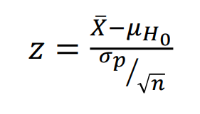
Z-Test for Testing Means
Test Condition
Population normal and infinite
Sample size large or small,
Population variance is known
Ha may be one-sided or two sided
Test Statistics

Slide 16
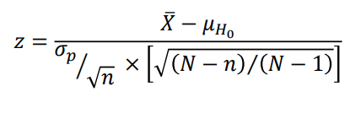
Z-Test for Testing Means
Test Condition
Population normal and finite
Sample size large or small,
Population variance is known
Ha may be one-sided or two sided
Test Statistics

Slide 17
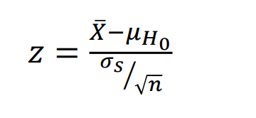
Z-Test for Testing Means
Test Condition
Population is infinite and may not be normal
Sample size is large,
Population variance is unknown
Ha may be one-sided or two sided
Test Statistics

Slide 18
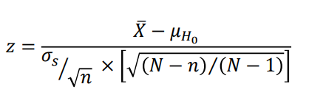
Z-Test for Testing Means
Test Condition
Population is finite and may not be normal
Sample size is large
Population variance is unknown
Ha may be one-sided or two sided
Test Statistics

Slide 19
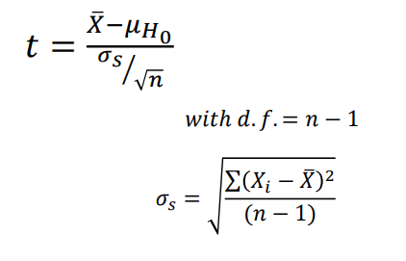
T-Test for Testing Means
Test Condition
Population is infinite and normal
Sample size is small
Population variance is unknown
Ha may be one-sided or two sided
Test Statistics

Slide 20
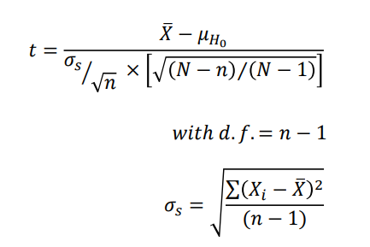
T-Test for Testing Means
Test Condition
Population is finite and normal
Sample size is small
Population variance is unknown
Ha may be one-sided or two sided
Test Statistics

Slide 21
Hypothesis Testing for difference between means
<Topic>
Z-Test, T-Test

Slide 22
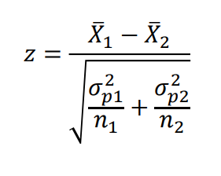
Z-Test for testing difference between means
Test Condition
Populations are normal
Samples happen to be large
Population variances are known
Ha may be one-sided or two sided
Test Statistics

Slide 23
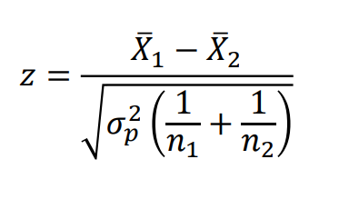
Z-Test for testing difference between means
Test Condition
Populations are normal
Samples happen to be large,
Presumed to have been drawn from the same population
Population variances are known
Ha may be one-sided or two sided
Test Statistics

Slide 24
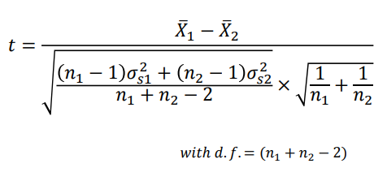
Z-Test for testing difference between means
Test Condition
Samples happen to be small
Presumed to have been drawn from the same population
Population variances are unknown but assumed to be equal
Ha may be one-sided or two sided
Test Statistics

Slide 25
Hypothesis Testing for comparing two related samples
<Topic>
Paired T- Test

Slide 26
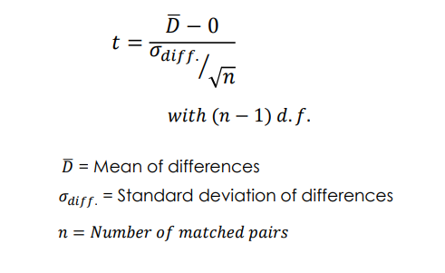
Paired T-Test for comparing two related samples
Test Condition
Samples happens to be small
Variances of the two populations need not be equal
Populations are normal
Ha may be one-sided or two sided
Test Statistics

Slide 27
Hypothesis Testing of Proportions
<Topic>
Z-Test

Slide 28
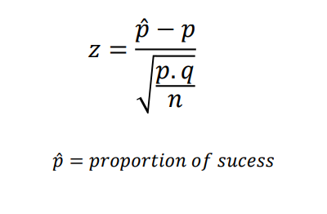
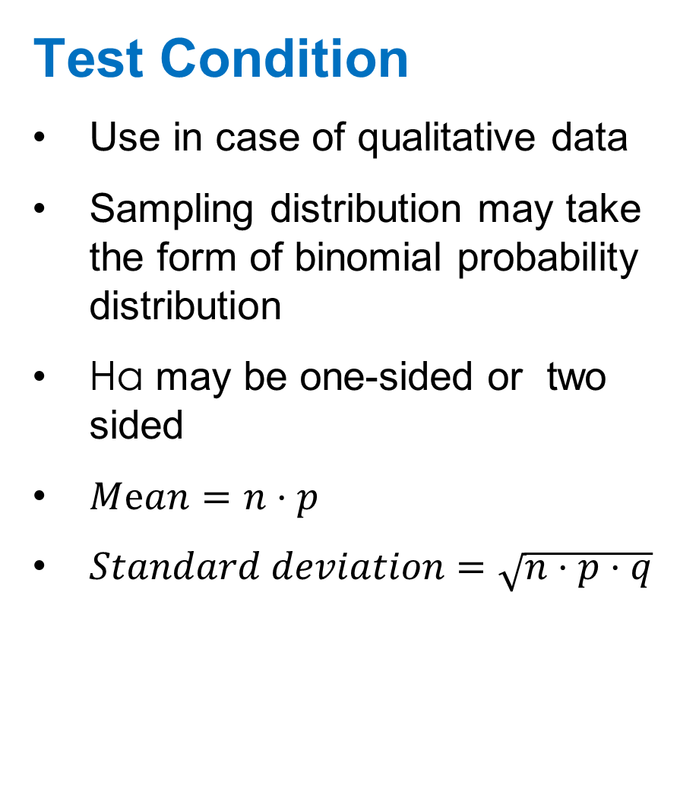
Z-Test for Testing of Proportions
Test Condition
Use in case of qualitative data
Sampling distribution may take the form of binomial probability distribution
Ha may be one-sided or two sided
$Mⅇan=n⋅p$
$Standard deviation=\sqrt{n⋅p⋅q}$
Test Statistics

Slide 29
Hypothesis Testing for difference between proportions
<Topic>
Z-Test

Slide 30
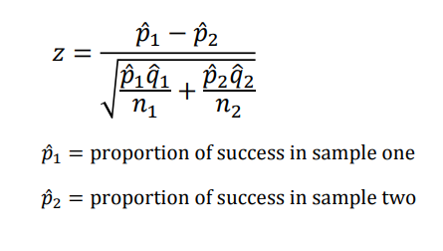
Z-test for testing difference between proportions
Test Condition
Sample drawn from two different populations
Test confirm, whether the difference between the proportion of success is significant
Ha may be one-sided or two sided
Test Statistics

Slide 31
Hypothesis testing of equality of variances of two normal populations
<Topic>
F-Test

Slide 32
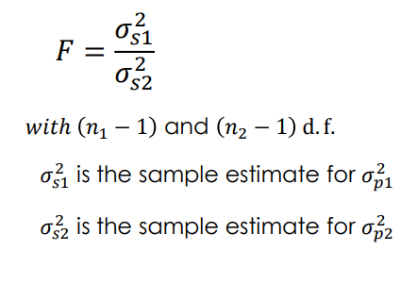
F-Test for testing equality of variances of two normal populations
Test Condition
The populations are normal
Samples have been drawn randomly
Observations are independent
There is no measurement error
Ha may be one-sided or two sided
Test Statistics

Slide 33
Limitations of the test of Hypothesis
Testing of hypothesis is not decision making itself; but help for decision making
Test does not explain the reasons as why the difference exist, it only indicate that the difference is due to fluctuations of sampling or because of other reasons but the tests do not tell about the reason causing the difference.
Tests are based on the probabilities and as such cannot be expressed with full certainty.
Statistical inferences based on the significance tests cannot be said to be entirely correct evidences concerning the truth of the hypothesis.
Notes:
The first question that arise in our mind is why Statistics?
Let me make you clear that Statistics is one of the key fundamental skills required for data science. Moving forward in the data science, if you go for any kind of algorithms then primarily knowledge in statistics is quite important. Actually, the statistics and probability are considered as the base knowledge and they are very essential for moving into any machine learning algorithms.

Slide 34
Choosing Python Statistics Libraries
<Topic>

Slide 35
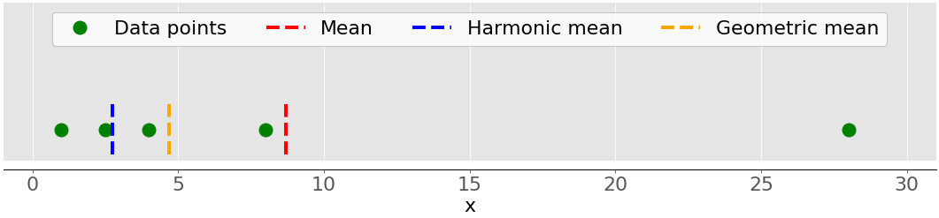
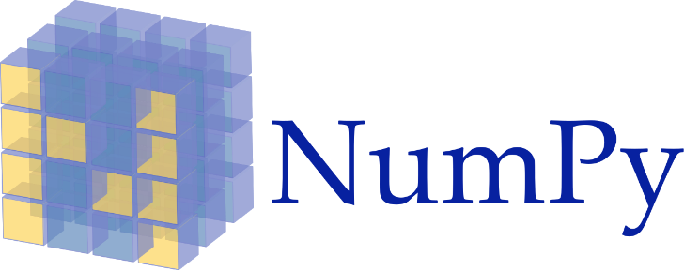
Python Statistics Libraries
There are many Python statistics libraries out there for you to work with, but these are some of the most popular and widely used ones:
Python’s statistics is a built-in Python library for descriptive statistics. You can use it if your datasets are not too large or if you can’t rely on importing other libraries.
NumPy is a third-party library for numerical computing, optimized for working with single- and multi-dimensional arrays. Its primary type is the array type called ndarray. This library contains many routines for statistical analysis.
Notes:
The first question that arise in our mind is why Statistics?
Let me make you clear that Statistics is one of the key fundamental skills required for data science. Moving forward in the data science, if you go for any kind of algorithms then primarily knowledge in statistics is quite important. Actually, the statistics and probability are considered as the base knowledge and they are very essential for moving into any machine learning algorithms.

Slide 36


Python Statistics Libraries
There are many Python statistics libraries out there for you to work with, but these are some of the most popular and widely used ones:
SciPy is a third-party library for scientific computing based on NumPy. It offers additional functionality compared to NumPy, including scipy.stats for statistical analysis.
Pandas is a third-party library for numerical computing based on NumPy. It excels in handling labeled one-dimensional (1D) data with Series objects and two-dimensional (2D) data with DataFrame objects.
Notes:
The first question that arise in our mind is why Statistics?
Let me make you clear that Statistics is one of the key fundamental skills required for data science. Moving forward in the data science, if you go for any kind of algorithms then primarily knowledge in statistics is quite important. Actually, the statistics and probability are considered as the base knowledge and they are very essential for moving into any machine learning algorithms.

Slide 37

Python Statistics Libraries
There are many Python statistics libraries out there for you to work with, but these are some of the most popular and widely used ones:
Matplotlib is a third-party library for data visualization. It works well in combination with NumPy, SciPy, and Pandas.
Notes:
The first question that arise in our mind is why Statistics?
Let me make you clear that Statistics is one of the key fundamental skills required for data science. Moving forward in the data science, if you go for any kind of algorithms then primarily knowledge in statistics is quite important. Actually, the statistics and probability are considered as the base knowledge and they are very essential for moving into any machine learning algorithms.

Slide 38


Thank You

